Slide 1
Machine Learning II
Day 9
Deep Learning
Débora Corrêa and Ayham Zaitouny
Research Fellows
ARC Centre for Transforming Maintenance through Data Science (UWA)
debora.correa@uwa.edu.au
ayham.zaitouny@uwa.edu.au

Slide 3

9
Introduce artificial neural networks and discuss architectures specially designed for images, sequence data and structured data.
Introduce the main concepts of deep learning and provide everyday industry examples.
Present the practical strategies to train neural networks.
Appreciate the powerful framework given by neural networks and deep learning techniques.
Recognise what types of data are required by such algorithms.
Have the general idea about how to train a neural network.
Know how to develop a project for classification/forecast with deep learning.

Slide 4


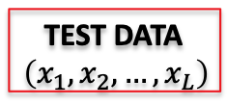
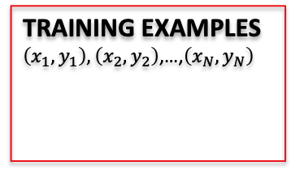
Day 09 Recap.
MSE
Precision
Recall
F1-score
Confusion matrix
Measures for
Imbalanced datasets
K fold cross validation
UNKOWN TARGET FUNCTION
$$f:χ →y$$
(e.g. ideal formula to predict when to replace a component)
TEST DATA
$$\left(x_{1},x_{2},…,x_{L}\right)$$
STUDY THE
PROBLEM
Random
Forests
K-NN
SVM
TRAINING EXAMPLES $\left(x_{1},y_{1}\right),\left(x_{2},y_{2}\right)$,…,$\left(x_{N},y_{N}\right)$
LEARNING
ALGORITHM
EVALUATE
APPLY
SOLUTION
$$\hat{f}≈f$$
(e.g. historical records of maintenance)
ANALYZE
ERRORS
Today: ANNs and deep learning.
Debora/Ayham (UWA)
Picture adapted from: Hands on Machine Learning with Scikit-Learn and TensorFlow, Cap 1.

Slide 5
Day 9 Outline
We will cover today:
Fundamentals and Multilayer Perceptrons
Training Artificial Neural Networks
Convolutional Neural Networks
Recurrent Neural Networks

Slide 6
Getting the Anaconda environment prepared
Go to GitHub /09-machinelearning and create the environment use: environment.yml
If you don’t have Anaconda: download it at https://www.anaconda.com/distribution/
Mac:
Open command prompt/terminal and type:
conda env create -f environment.yml
conda activate day09
Win:
Open command prompt/terminal and type:
conda env create -f environment.yml
activate day09
Or use Anaconda Interface (GUI)
Débora and Ayham (ARC ITTC/UWA)

Slide 7
Day 09 Fundamentals of Deep Learning

Slide 8
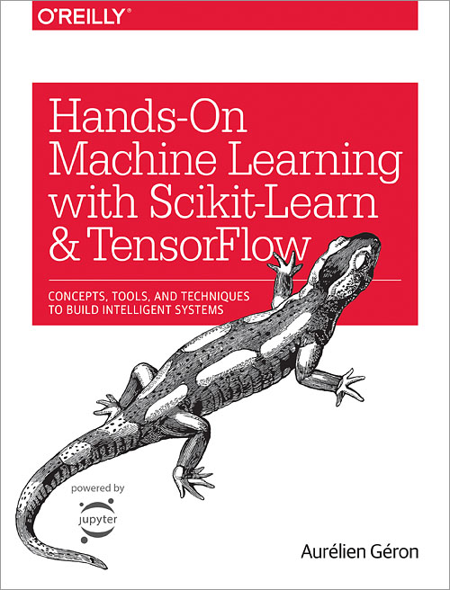
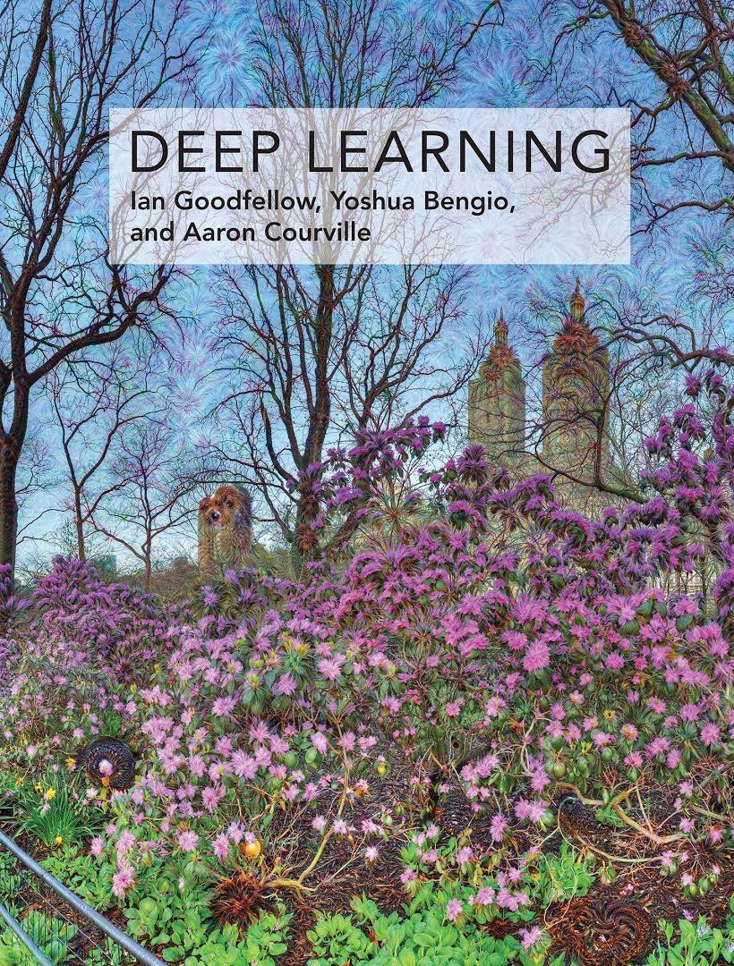
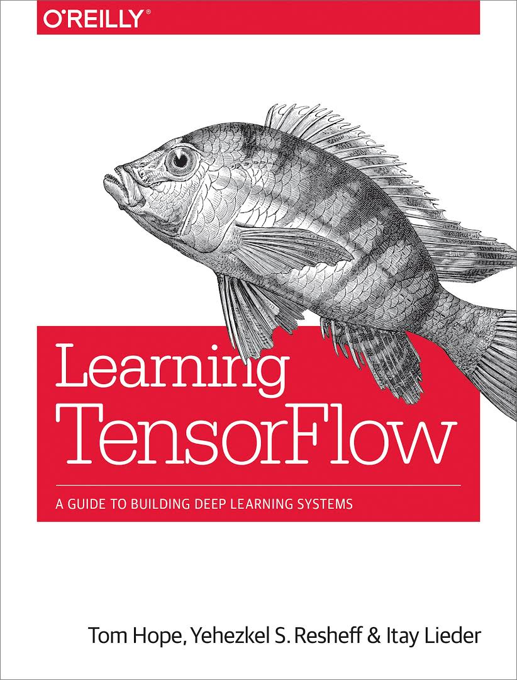
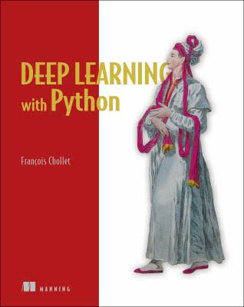
Day 09 Suggested references
Scikit-learn: http://scikit-learn.org
TensorFlow: https://www.tensorflow.org
Andrew Ng deep learning page: https://www.deeplearning.ai
Debora/Ayham (UWA)

Slide 9
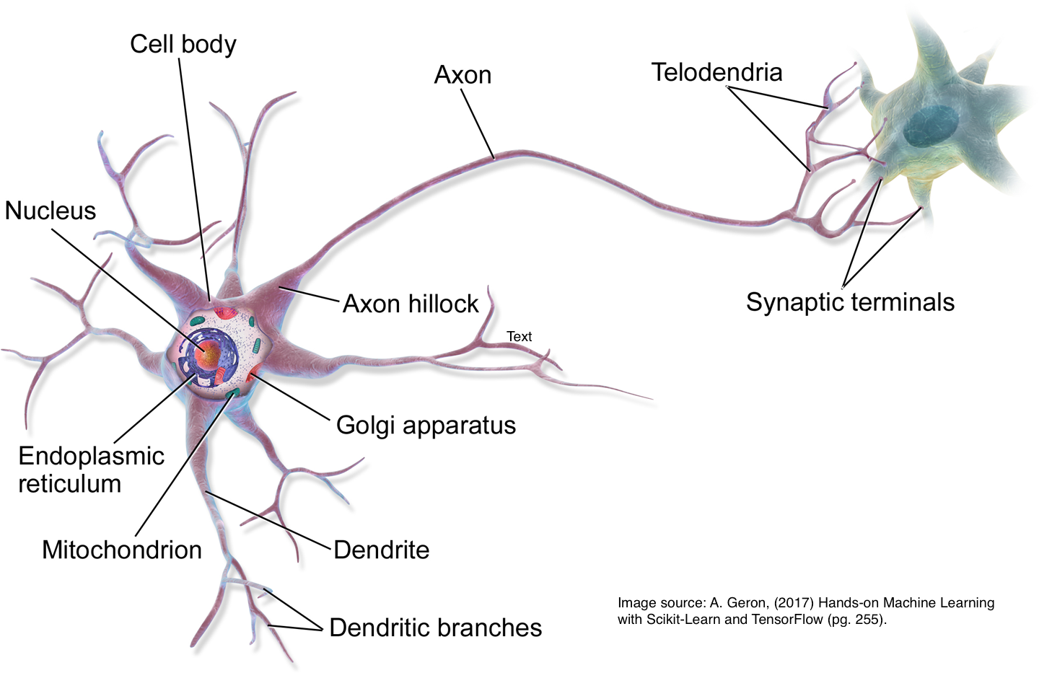
Day 09 ANNs Neuro-inspired computation
Artificial neural networks (ANNs): family of models with a gross inspiration from the brain.
Excellent pattern recognition models.
Excellent on unstructured data.
Biological neuron
Artificial neuron
Our brain: about 86 billion neurons¹.
Largest ANN: about million neurons².
1 https://www.nature.com/scitable/blog/brain-metrics/
2 https://phys.org/2018-06-ai-method-power-artificial-neural.html
Debora/Ayham (UWA)

Slide 10
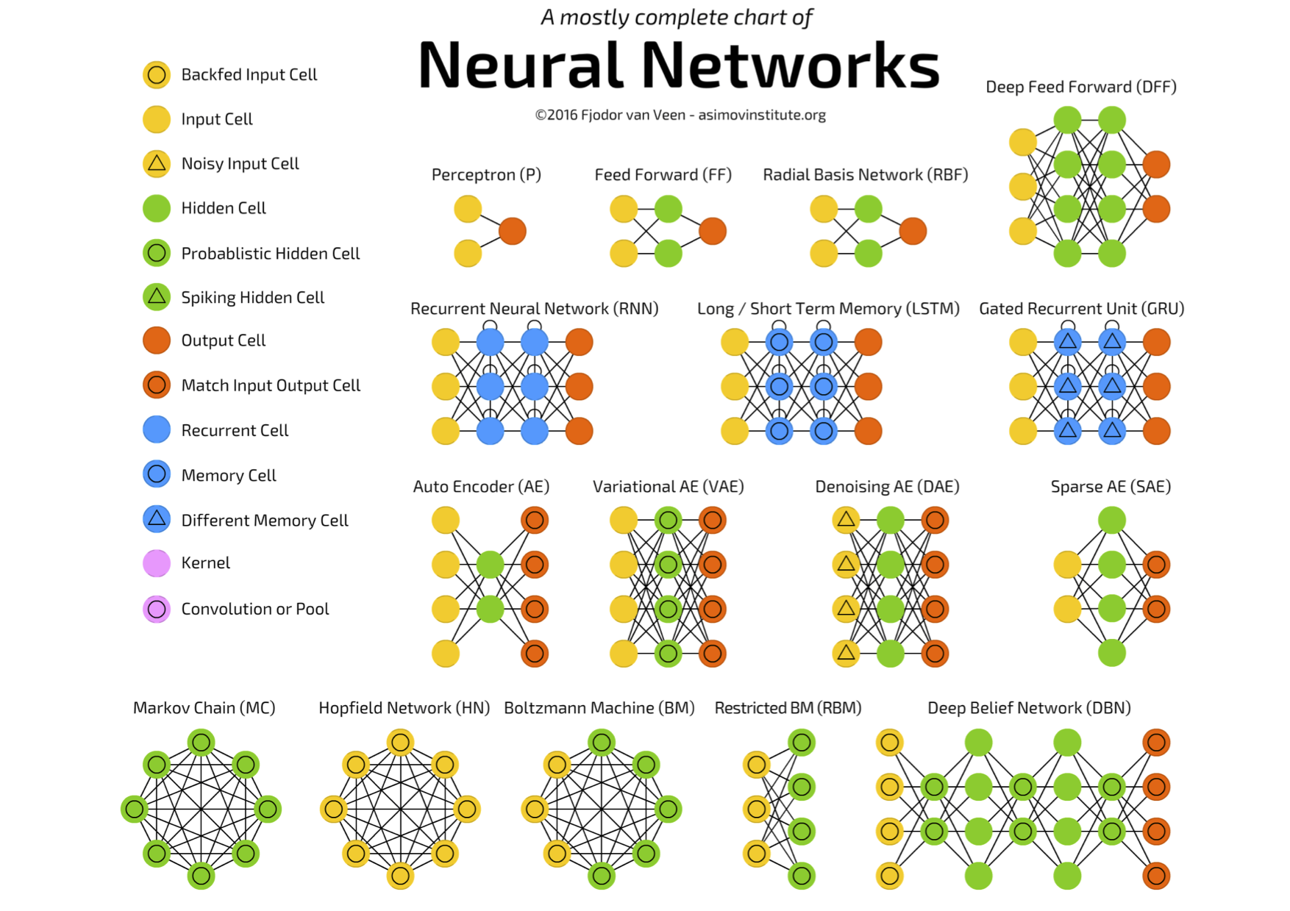
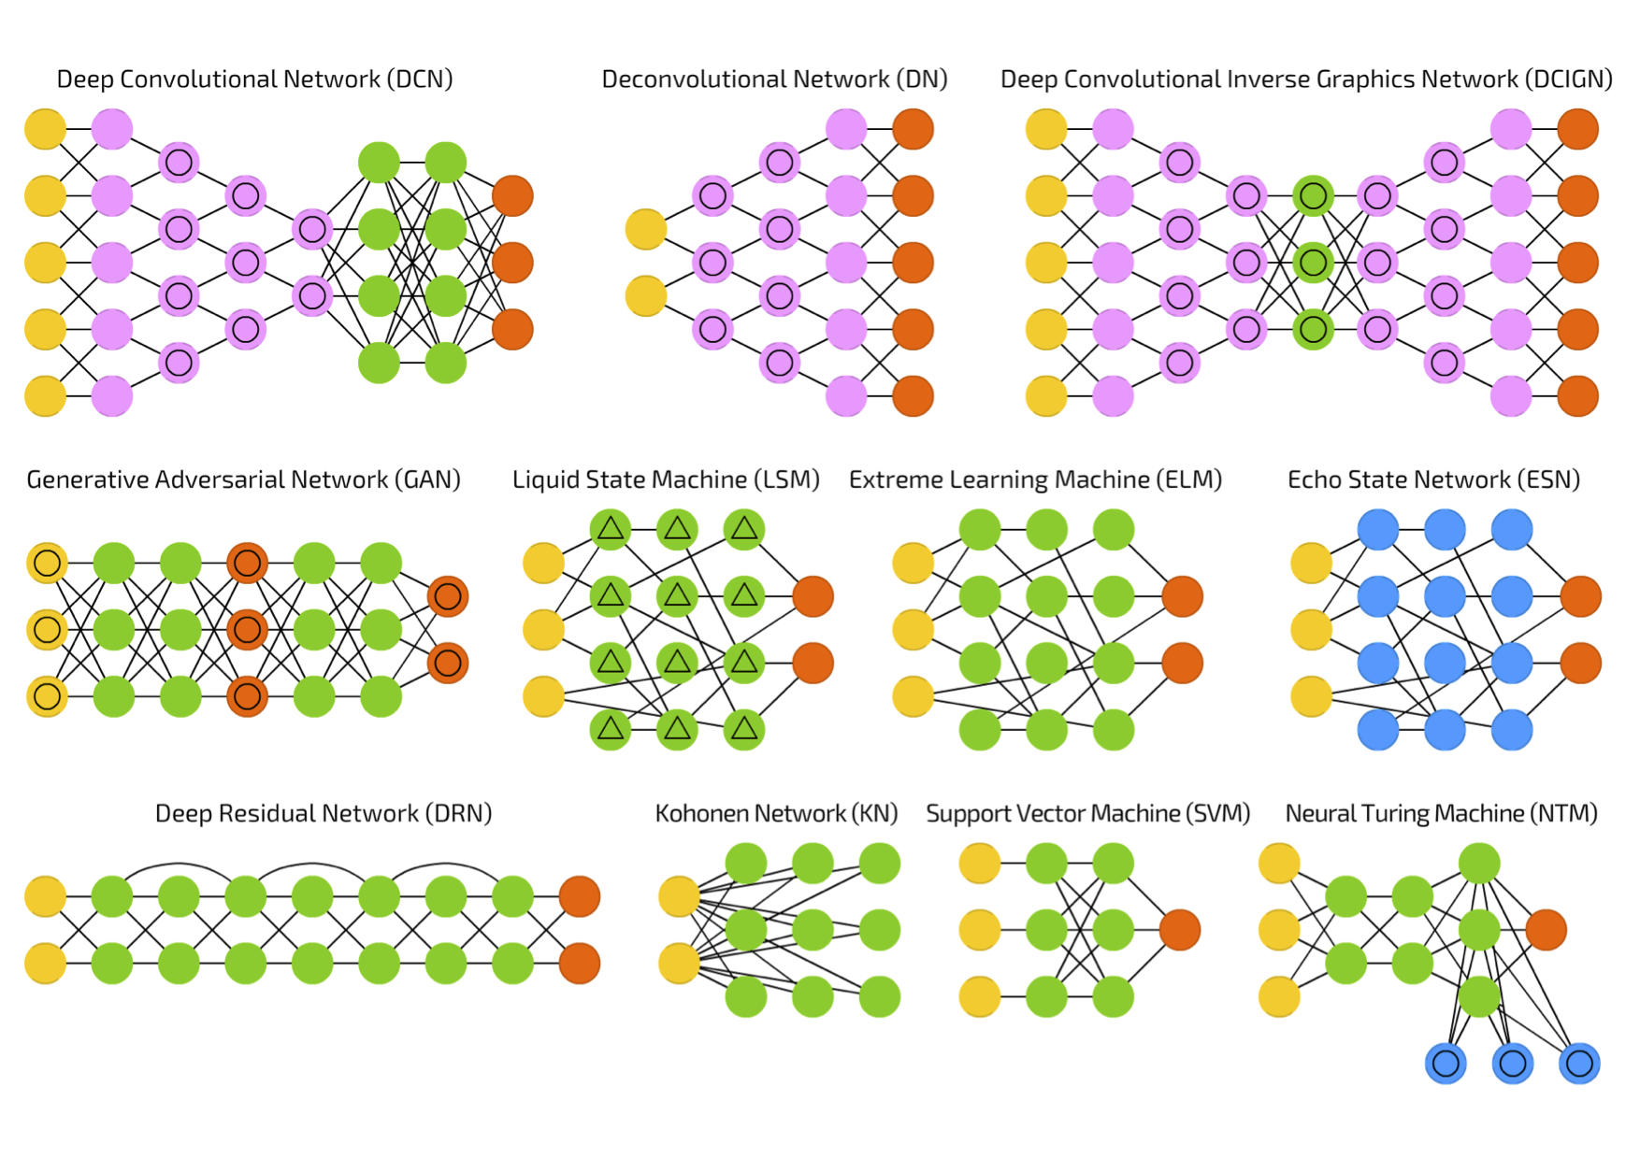
Day 09 ANNs and their flavours
ANNs are general function approximators and perform well when learning a complex mapping from the input to the output space.
What the network should capture in order to perform such mapping? What should be the input and the output?
Chart available at: https://towardsdatascience.com/the-mostly-complete-chart-of-neural-networks-explained-3fb6f2367464

Slide 11
Day 09 ANNs and applications
Structured data
Multilayer Perceptrons
Input: features, data matrix (samples x features)
Classification, regression.
Image data
Convolutional Neural Networks
Input: images
Classification (objects, face, scene, action, etc.)
Sequence data
Recurrent Neural Networks
Input: time series, audio, text
Classification, speech recognition, prediction.
Different types of data
Autoencoders
Input: original data representation
Dimensionality reduction, pre-training, data reconstruction.
Combination of different ANNs is also very common.

Slide 12
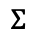
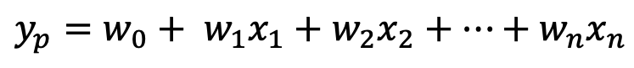
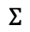
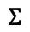
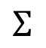
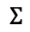
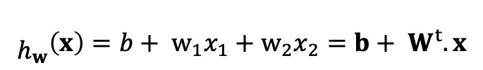
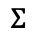
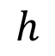
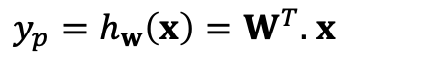
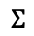
Day 09 Linear Models
Linear Regression
$$y_{p}=w_{0}+ w_{1}x_{1}+w_{2}x_{2}+…+w_{n}x_{n}$$
$y_{p}=h_{w}\left(x\right)=W^{T}.$ $x$
$$h$$
How to include nonlinearity?
Stack layers with intermediary values?
$$Σ$$
$$Σ$$
$$Σ$$
$$Σ$$
bias
b
1
w₁
w₂
weights
1
$$Σ$$
$$Σ$$
$$Σ$$
x₁
x₂
Input features
1
$${\begin{aligned} \\ h\end{aligned}}_{w}\left(x\right)=b+ w_{1}x_{1}+w_{2}x_{2}={b+ W}^{t}.x$$
x₁
x₂
But, it is still a linear model!
Outputs are linear combination of inputs.

Slide 13
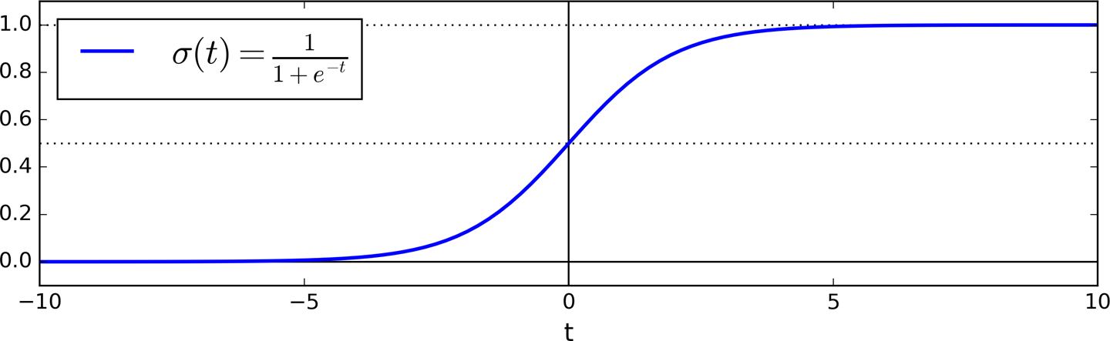
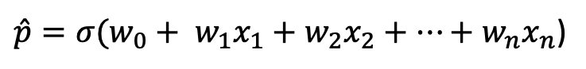
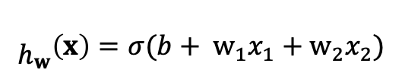
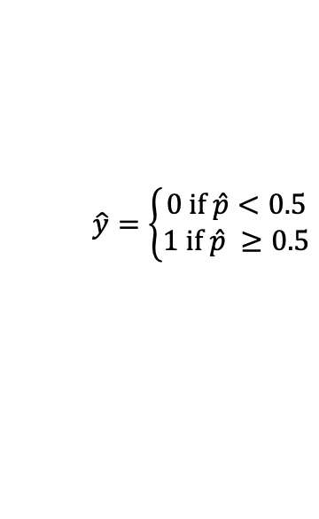
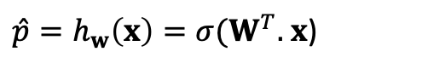
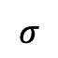
Day 09 Logistic Regression
Similar to Liner Regression: the model computes a weighted sum of the input features and add a bias term.
Output: Logistic function applied on the resulting sum.
$\hat{p}={σ(w}_{0}+ w_{1}x_{1}+w_{2}x_{2}+…+w_{n}x_{n}$)
$\hat{p}=h_{w}\left(x\right)={σ(W}^{T}.$ $x$)
predicted class
$$\hat{y}=\left\{\begin{aligned}0 if \hat{p}<0.5 \\ 1 if \hat{p} ≥0.5\end{aligned}\right.$$
$$σ$$
$${\begin{aligned} \\ h\end{aligned}}_{w}\left(x\right)=σ(b+ w_{1}x_{1}+w_{2}x_{2})$$
$$Σ$$
b
1
w₁
w₂
ANNs follow the same idea: we transform the output of a neuron using nonlinear transformation.
x₁
x₂
Debora/Ayham (UWA)

Slide 14
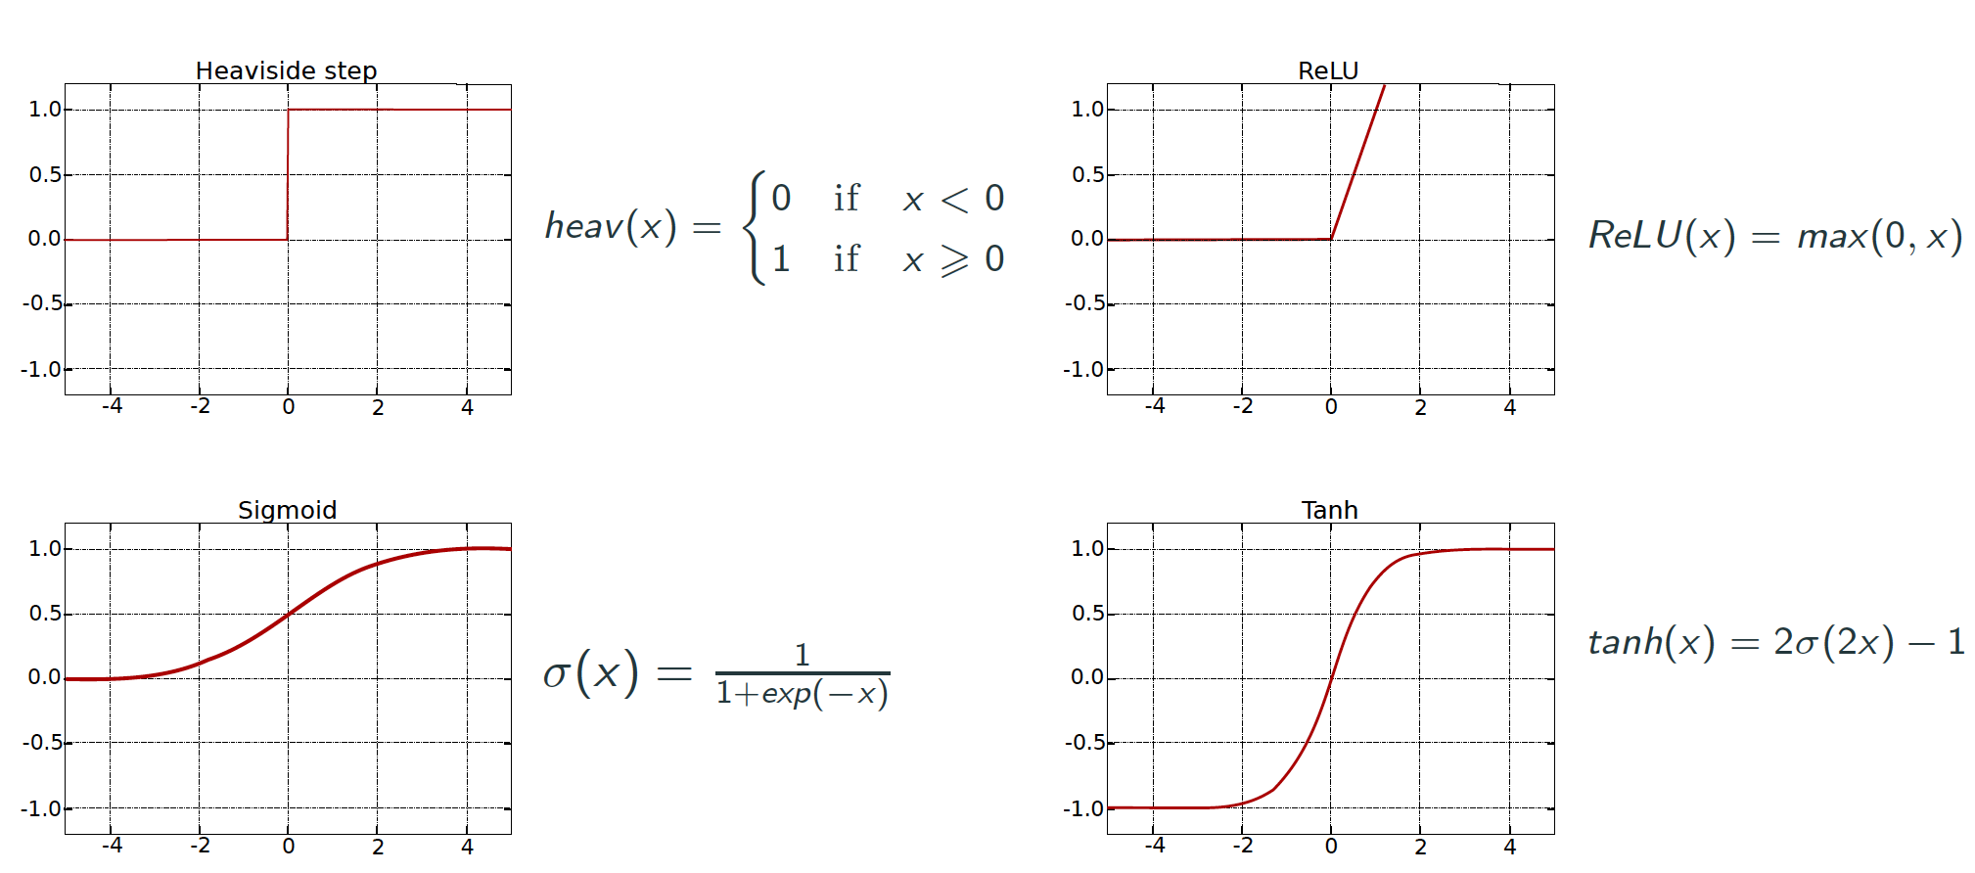
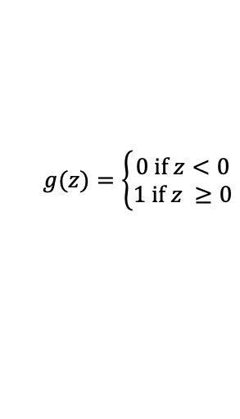
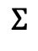
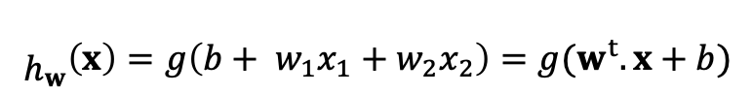
Day 09 Perceptron
Linear Threshold Units (LTUs) – Proposed by Frank Rosenblatt in 1957
$${\begin{aligned} \\ h\end{aligned}}_{w}\left(x\right)=g\left({b+ w}_{1}x_{1}+w_{2}x_{2}\right)=g(w^{t}.x+b)$$
output
$$g(z)=\left\{\begin{aligned}0 if z<0 \\ 1 if z ≥0\end{aligned}\right.$$
g
LTU
$$Σ$$
bias
b
The weights and bias are the parameters to be learned.
1
w₁
w₂
weights
Single LTU: simple linear binary classification.
input layer
x₁
x₂

Slide 15
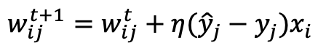
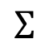
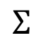
Day 09 Perceptron (Cont.)
The perceptron can do multiclass classification
outputs
Perceptron learning rule (weight update)
g
g
g
LTUs
$$w_{ij}^{t+1}=w_{ij}^{t}+η({\hat{y}}_{j}−y_{j})x_{i}$$
$$Σ$$
$$Σ$$
$$Σ$$
learning rate
1
x₁
x₂
If the classes are linearly separable, Perceptron will converge to a solution:
Perceptron convergence theorem
Debora/Ayham (UWA)
Source: Hands on Machine Learning with Scikit-Learn and TensorFlow, Cap. 10.

Slide 16
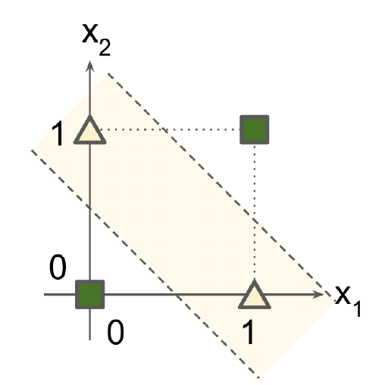
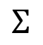
Day 09 From Perceptrons to MLPs
MultiLayer Perceptron
XOR classification problem
g
output layer
$$Σ$$
1
g
g
hidden layer
$$Σ$$
$$Σ$$
1
x₁
x₂
input layer
Perceptron can not solve this!
Source: Hands on Machine Learning with Scikit-Learn and TensorFlow, Cap. 10.

Slide 17
Day 09 Activation functions
Idea: Transformation the output of a neuron by a nonlinear function.
Normalization of the output (prevent outputs to explode due to the cascading effect).
This allows neural networks to learn complex patterns and deal with variability in the data.
Decision making at the output of a neuron.

Slide 18
Day 09 Multilayer Perceptrons
Used for the predictions.
For regression, linear activation
functions can be used, or no activation function at all.
g
g
g
output layer
$$Σ$$
$$Σ$$
$$Σ$$
g
g
g
g
1
hidden layer
Compute complex function by cascading simpler functions.
$$Σ$$
$$Σ$$
$$Σ$$
$$Σ$$
1
x₁
x₂
input layer
Provides input data to the network.
Deep Learning: when an ANN has two or more hidden layers.
Source: Hands on Machine Learning with Scikit-Learn and TensorFlow, Cap. 10.

Slide 19
Day 09 MLPs (Cont.)
Softmax
softmax
output layer
For exclusive classification
$$Σ$$
$$Σ$$
$$Σ$$
g
g
g
g
1
hidden layer
$$Σ$$
$$Σ$$
$$Σ$$
$$Σ$$
Feedforward neural network
1
x₁
x₂
input layer
Source: Hands on Machine Learning with Scikit-Learn and TensorFlow, Cap. 10.

Slide 20
Day 09 Practice
Interactive Google platform for playing with ANNs
playground.tensorflow.org
Let’s create simple feedforward ANNs and see some effects of training in real time. ☺
Débora/Ayham (UWA)

Slide 21
Day 09 Practice (Cont.)
Part 1: No hidden layers
Select the third dataset.
Train the network using X₁ and X₂.
Select the first dataset.
Do the same: train the network using X₁ and X₂. What happened?
Explore the data structure. It has circular characteristics.
Include the square values of the features, X₁² and X₂², and train the network again. What happened?
Check if these new features can do a good job in the second and fourth datasets.
Explore the data structure of the second dataset. What combination of feature can we use?
Try to use only X₁ and X₂ with a nonlinear activation function.
Include a product of the features, X₁X₂ and do the training again.
Check if you get any good classification performance on the fourth dataset.
Débora/Ayham (UWA)

Slide 22
Day 09 Practice (Cont.)
Part 2: Adding hidden layers
Include one hidden layer with one neuron, use only features X₁ and X₂.
Select the second dataset. Do the training using a linear activation function and with a sigmoid or tanh activation function.
Include one neuron in the hidden layer. Do step a) again.
Keep the nonlinear activation function and include one more hidden layers. Does it improve the performance? Does it take long to train?
Repeat some of these steps for a few times to see the effect of the random initialization of the weights.
Select the first dataset.
Do the training using one hidden layer with two neurons (you can use the sigmoid activation function).
Now, include one more neuron in the hidden layer. What happened?
Explore different configurations of hidden layers, number of hidden neuros and activation functions on the datasets.
Débora/Ayham (UWA)

Slide 23
Day 09 Training ANNs

Slide 24
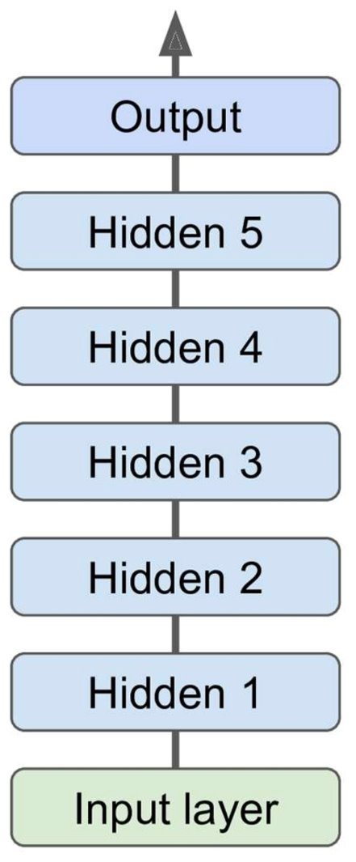
Multi-layer Perceptrons
*Deep neural network (DNN), when an ANN has two or more hidden layers
One output layer
One or more hidden layers
One input layer
Débora/Ayham (UWA)

Slide 25
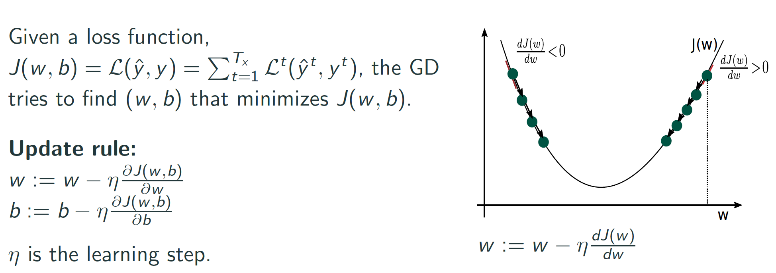
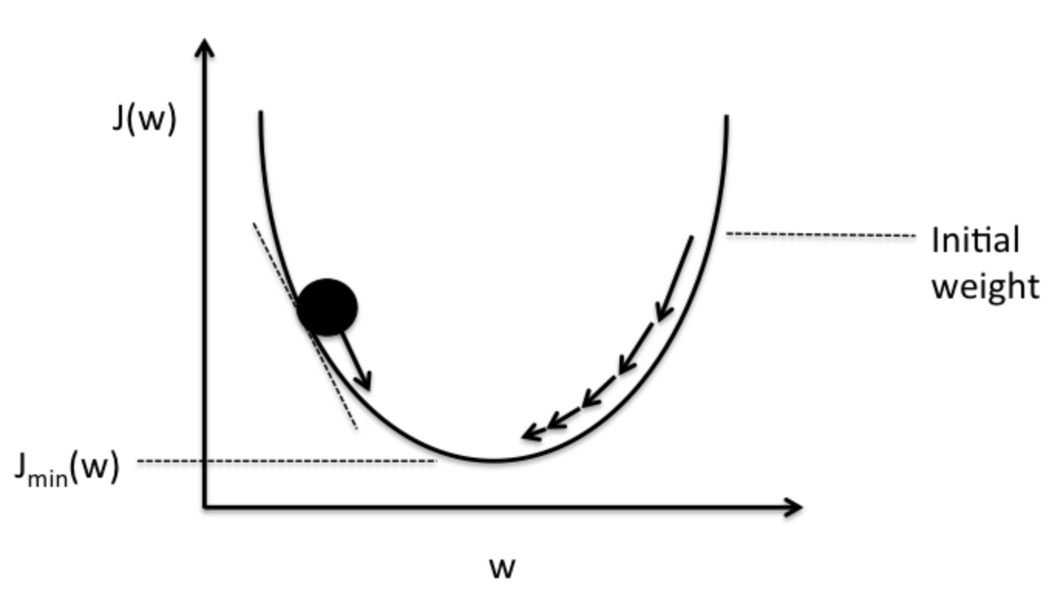
Day 09 Gradient-based learning algorithm
Gradient Descent:
Iterative optimization approach.
Idea: tweak parameters of the model to minimize a loss function over the training set.
It computes the error derivatives with respect to each parameter of the model.
Increase weight
Decrease weight
https://medium.com/datathings/neural-networks-and-backpropagation-explained-in-a-simple-way-f540a3611f5e

Slide 26
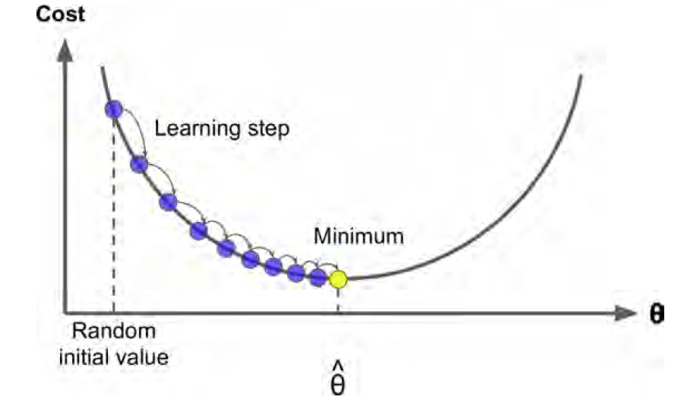
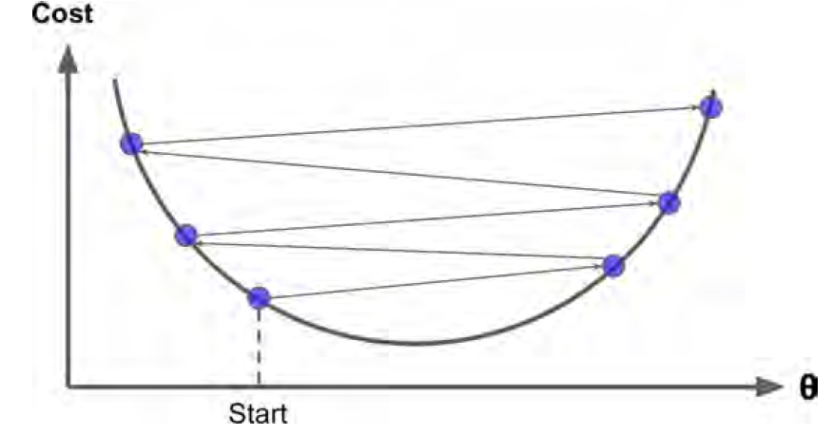
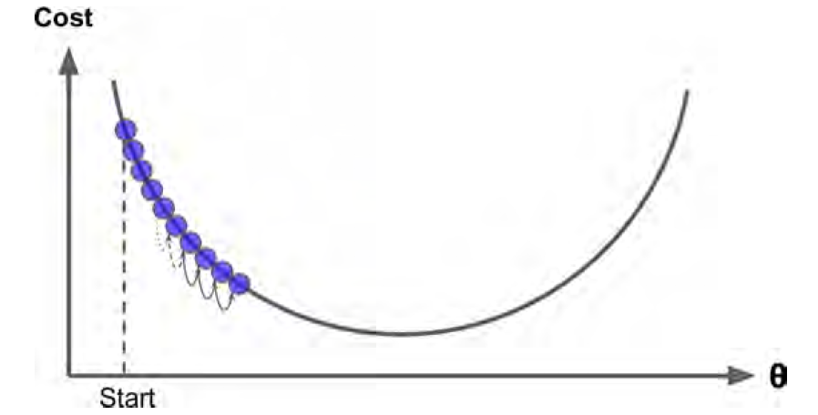
Day 09 Gradient-based learning algorithm
Gradient Descent:
Iterative optimization approach.
Idea: tweak parameters of the model to minimize a loss function over the training set.
It computes the error derivatives with respect to each parameter of the model.
Source: Hands on Machine Learning with Scikit-Learn and TensorFlow, Cap. 4

Slide 27

Stochastic Gradient Descent
Gradient Descend (GD) uses the whole training set to compute the errors (gradients) at every step.
GD is slow for training large data sets.
SGD picks random instances of the training set at every step and computes the errors based only on that instances.
Less regular than GD, but it is feasible for large data sets.
Débora/Ayham (UWA)

Slide 28
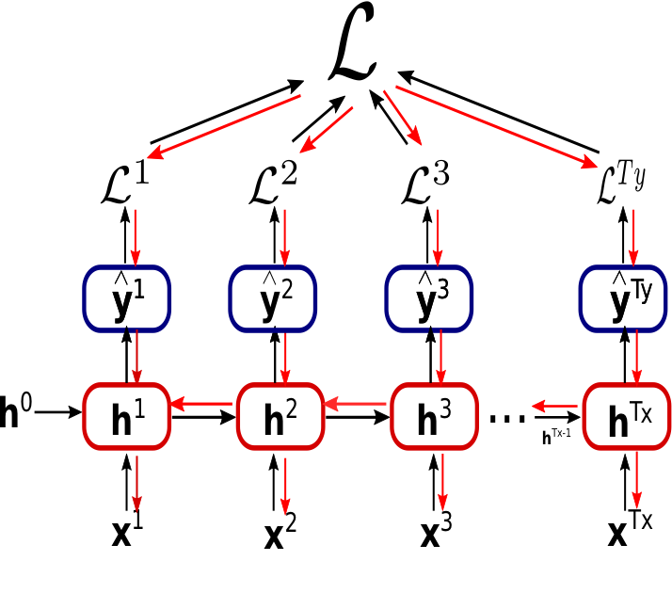
Back Propagation Training Algorithm
For each instance fed to the network, the backpropagation algorithm first makes a prediction (forward pass)
Then measures the error and goes through each layer in reverse to measure the contribution from each neuron (backward pass)
Finally, the algorithm tunes the neuron weights to reduce the error (gradient descent step)
Débora/Ayham (UWA)

Slide 29
Back Propagation Training Algorithm
For each instance fed to the network, the backpropagation algorithm first makes a prediction (forward pass)
Then measures the error and goes through each layer in reverse to measure the contribution from each neuron (backward pass)
Finally, the algorithm tunes the neuron weights to reduce the error (gradient descent step)
Débora/Ayham (UWA)

Slide 30
Back Propagation Training Algorithm
For each instance fed to the network, the backpropagation algorithm first makes a prediction (forward pass)
Then measures the error and goes through each layer in reverse to measure the contribution from each neuron (backward pass)
Finally, the algorithm tunes the neuron weights to reduce the error (gradient descent step)
Débora/Ayham (UWA)

Slide 31
MLPs Hyperparameters
Challenges in training MLPs – Many hypermeters to tune:
Débora/Ayham (UWA)

Slide 32
MLPs Hyperparameters
Challenges in training MLPs – Many hypermeters to tune:
Number of hidden layers: for many problems, one or two hidden layers are sufficient. For more complex problems, we can gradually increase the number of hidden layers until we start overfitting the training set. Very complex problems (large image classification or speech recognition), require dozens of layers and they need huge amount of training set. (Hierarchical Structure)
Number of neurons per hidden layer: number of neurons in the input and output layers is determined by your task. A common practice is to size the number of neurons in hidden layers to form a funnel (fewer and fewer neurons at each higher layer). A simpler approach is to pick a model with more layers and neurons than actually need, then use regularization (e.g. dropout) to prevent overfitting.
Activation functions: ReLU in hidden layers is a bit faster to compute than other activation functions, and Gradient Descent does not get stuck as much on local minima. For output layer: Softmax is generally a good choice for classification, for regression you can use no activation function at all.
Weight initialization logic
Débora/Ayham (UWA)

Slide 33
MLPs Hyperparameters
Challenges in training MLPs – Many hypermeters to tune:
Number of hidden layers: for many problems, one or two hidden layers are sufficient. For more complex problems, we can gradually increase the number of hidden layers until we start overfitting the training set. Very complex problems (large image classification or speech recognition), require dozens of layers and they need huge amount of training set. (Hierarchical Structure)
Number of neurons per hidden layer: number of neurons in the input and output layers is determined by your task. A common practice is to size the number of neurons in hidden layers to form a funnel (fewer and fewer neurons at each higher layer). A simpler approach is to pick a model with more layers and neurons than actually need, then use regularization (e.g. dropout) to prevent overfitting.
Activation functions: ReLU in hidden layers is a bit faster to compute than other activation functions, and Gradient Descent does not get stuck as much on local minima. For output layer: Softmax is generally a good choice for classification, for regression you can use no activation function at all.
Weight initialization logic
Débora/Ayham (UWA)

Slide 34
MLPs Hyperparameters
Challenges in training MLPs – Many hypermeters to tune:
Number of hidden layers: for many problems, one or two hidden layers are sufficient. For more complex problems, we can gradually increase the number of hidden layers until we start overfitting the training set. Very complex problems (large image classification or speech recognition), require dozens of layers and they need huge amount of training set. (Hierarchical Structure)
Number of neurons per hidden layer: number of neurons in the input and output layers is determined by your task. A common practice is to size the number of neurons in hidden layers to form a funnel (fewer and fewer neurons at each higher layer). A simpler approach is to pick a model with more layers and neurons than actually need, then use regularization (e.g. dropout) to prevent overfitting.
Activation functions: ReLU in hidden layers is a bit faster to compute than other activation functions, and Gradient Descent does not get stuck as much on local minima. For output layer: Softmax is generally a good choice for classification, for regression you can use no activation function at all.
Weight initialization logic
Débora/Ayham (UWA)

Slide 35
MLPs Hyperparameters
Challenges in training MLPs – Many hypermeters to tune:
Number of hidden layers: for many problems, one or two hidden layers are sufficient. For more complex problems, we can gradually increase the number of hidden layers until we start overfitting the training set. Very complex problems (large image classification or speech recognition), require dozens of layers and they need huge amount of training set. (Hierarchical Structure)
Number of neurons per hidden layer: number of neurons in the input and output layers is determined by your task. A common practice is to size the number of neurons in hidden layers to form a funnel (fewer and fewer neurons at each higher layer). A simpler approach is to pick a model with more layers and neurons than actually need, then use regularization (e.g. dropout) to prevent overfitting.
Activation functions: ReLU in hidden layers is a bit faster to compute than other activation functions, and Gradient Descent does not get stuck as much on local minima. For output layer: Softmax is generally a good choice for classification, for regression you can use no activation function at all.
Weight initialization logic
Débora/Ayham (UWA)

Slide 36
MLPs Hyperparameters
Challenges in training MLPs – Many hypermeters to tune:
Number of hidden layers: for many problems, one or two hidden layers are sufficient. For more complex problems, we can gradually increase the number of hidden layers until we start overfitting the training set. Very complex problems (large image classification or speech recognition), require dozens of layers and they need huge amount of training set. (Hierarchical Structure)
Number of neurons per hidden layer: number of neurons in the input and output layers is determined by your task. A common practice is to size the number of neurons in hidden layers to form a funnel (fewer and fewer neurons at each higher layer). A simpler approach is to pick a model with more layers and neurons than actually need, then use regularization (e.g. dropout) to prevent overfitting.
Activation functions: ReLU in hidden layers is a bit faster to compute than other activation functions, and Gradient Descent does not get stuck as much on local minima. For output layer: Softmax is generally a good choice for classification, for regression you can use no activation function at all.
Weight initialization logic
* In theory, we could use cross-validation but it costs a lot of time and computations
Débora/Ayham (UWA)

Slide 37
Tools and strategies for training MLPs/DNN
Problems faced through training a DNN:
Débora/Ayham (UWA)

Slide 38
Tools and strategies for training MLPs/DNN
Problems faced through training a DNN:
Vanishing gradients problem (or the related, exploding gradients problem) that makes lower layers very hard to train: backpropagation works by going from the output layer to the input layer. The gets smaller and smaller as the algorithm progresses down, as a result the gradient descent update leaves the lower layer connection weights unchanged and training never converges to a good solution.
Training DNNs would be very slow with large networks
A DNN with many parameters would severely risk overfitting the training set
Débora/Ayham (UWA)

Slide 39
Tools and strategies for training MLPs/DNN
Problems faced through training a DNN:
Vanishing gradients problem (or the related, exploding gradients problem) that makes lower layers very hard to train: backpropagation works by going from the output layer to the input layer. The gets smaller and smaller as the algorithm progresses down, as a result the gradient descent update leaves the lower layer connection weights unchanged and training never converges to a good solution.
Training DNNs would be very slow with large networks
A DNN with many parameters would severely risk overfitting the training set
Popular strategies to solve vanishing/exploding gradients problem
Débora/Ayham (UWA)

Slide 40
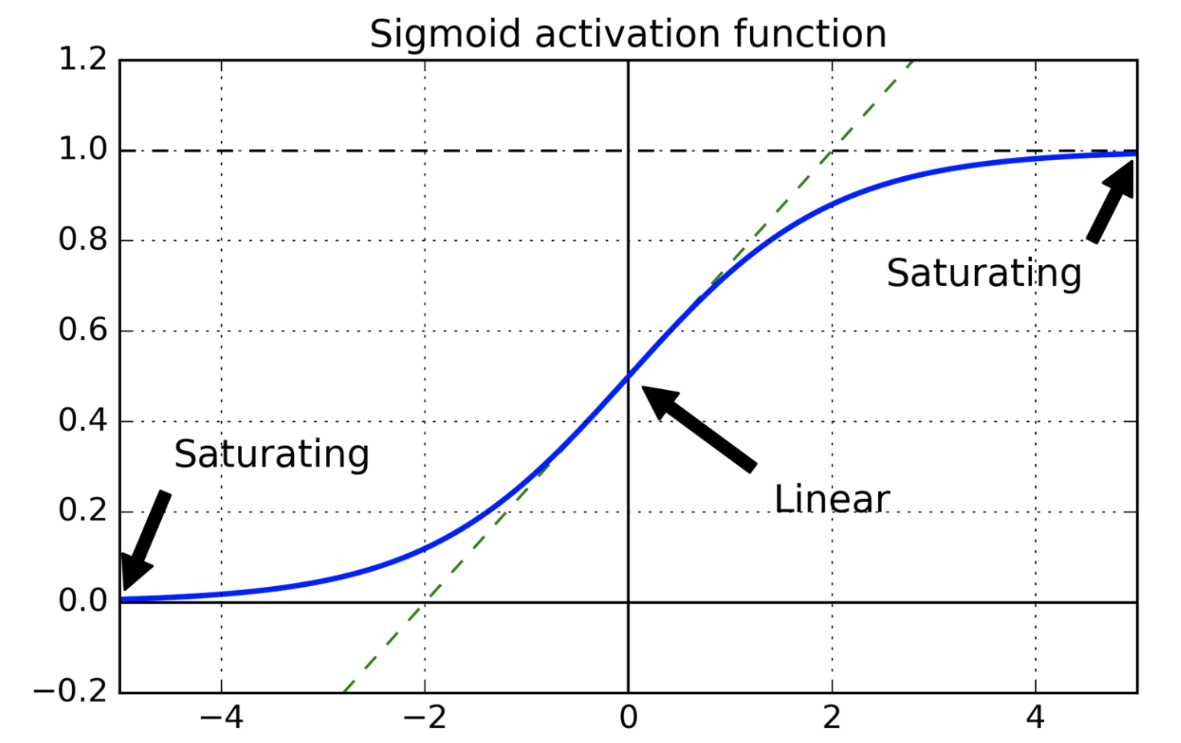
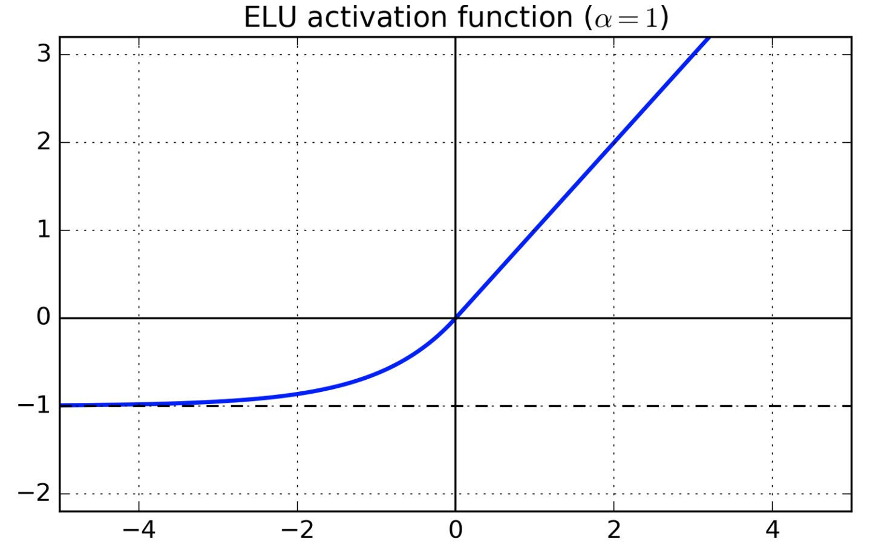
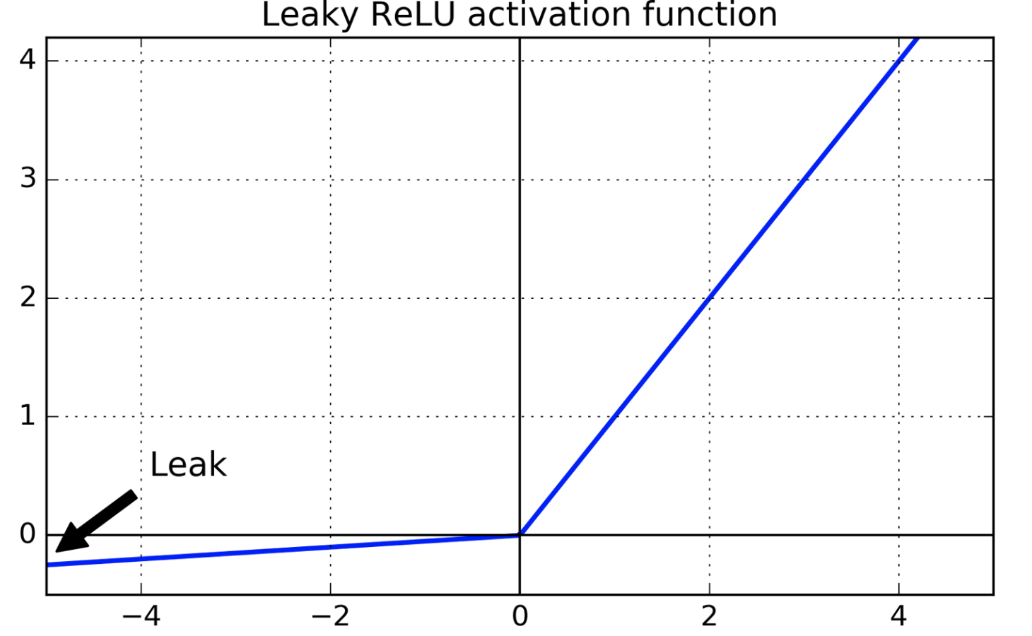
Tools and strategies for training MLPs/DNN
Strategies to solve vanishing/exploding gradients problems:
Input normalization (zero mean and unit std)
Xavier/Glorot weight initialization
Nonsaturating activation functions:
Exponential Linear Unit (ELU) Leaky ReLU
Batch Normalization:
Zero-centre and normalization of the inputs in each layer before activation function is computed
Gradient clipping:
Used for exploding gradients
Rescale gradients to prevent they exceed a maximum threshold
Débora/Ayham (UWA)

Slide 41
Tools and strategies for training MLPs/DNN
Problems faced through training a DNN:
Vanishing gradients problem (or the related, exploding gradients problem) that makes lower layers very hard to train: backpropagation works by going from the output layer to the input layer. The gets smaller and smaller as the algorithm progresses down, as a result the gradient descent update leaves the lower layer connection weights unchanged and training never converges to a good solution.
Training DNNs would be very slow with large networks
A DNN with many parameters would severely risk overfitting the training set
Popular strategies to solve vanishing/exploding gradients problem
Débora/Ayham (UWA)

Slide 42
Tools and strategies for training MLPs/DNN
Problems faced through training a DNN:
Vanishing gradients problem (or the related, exploding gradients problem) that makes lower layers very hard to train: backpropagation works by going from the output layer to the input layer. The gets smaller and smaller as the algorithm progresses down, as a result the gradient descent update leaves the lower layer connection weights unchanged and training never converges to a good solution.
Training DNNs would be very slow with large networks
A DNN with many parameters would severely risk overfitting the training set
Popular strategies to solve vanishing/exploding gradients problem
Faster optimizers that can speed up the training
Débora/Ayham (UWA)

Slide 43
Tools and strategies for training MLPs/DNN
Faster optimizers (variations of the Stochastic Gradient Descent):
Momentum optimization
Nesterov Accelerated Gradient
AdaGrad
RMSProp
Adam Optimization
Learning Rate Scheduling
Débora/Ayham (UWA)

Slide 44
Tools and strategies for training MLPs/DNN
Problems faced through training a DNN:
Vanishing gradients problem (or the related, exploding gradients problem) that makes lower layers very hard to train: backpropagation works by going from the output layer to the input layer. The gets smaller and smaller as the algorithm progresses down, as a result the gradient descent update leaves the lower layer connection weights unchanged and training never converges to a good solution.
Training DNNs would be very slow with large networks
A DNN with many parameters would severely risk overfitting the training set
Popular strategies to solve vanishing/exploding gradients problem
Faster optimizers that can speed up the training
Débora/Ayham (UWA)

Slide 45
Tools and strategies for training MLPs/DNN
Problems faced through training a DNN:
Vanishing gradients problem (or the related, exploding gradients problem) that makes lower layers very hard to train: backpropagation works by going from the output layer to the input layer. The gets smaller and smaller as the algorithm progresses down, as a result the gradient descent update leaves the lower layer connection weights unchanged and training never converges to a good solution.
Training DNNs would be very slow with large networks
A DNN with many parameters would severely risk overfitting the training set
Popular strategies to solve vanishing/exploding gradients problem
Faster optimizers that can speed up the training
Popular regularization techniques to avoid overfitting
Débora/Ayham (UWA)

Slide 46
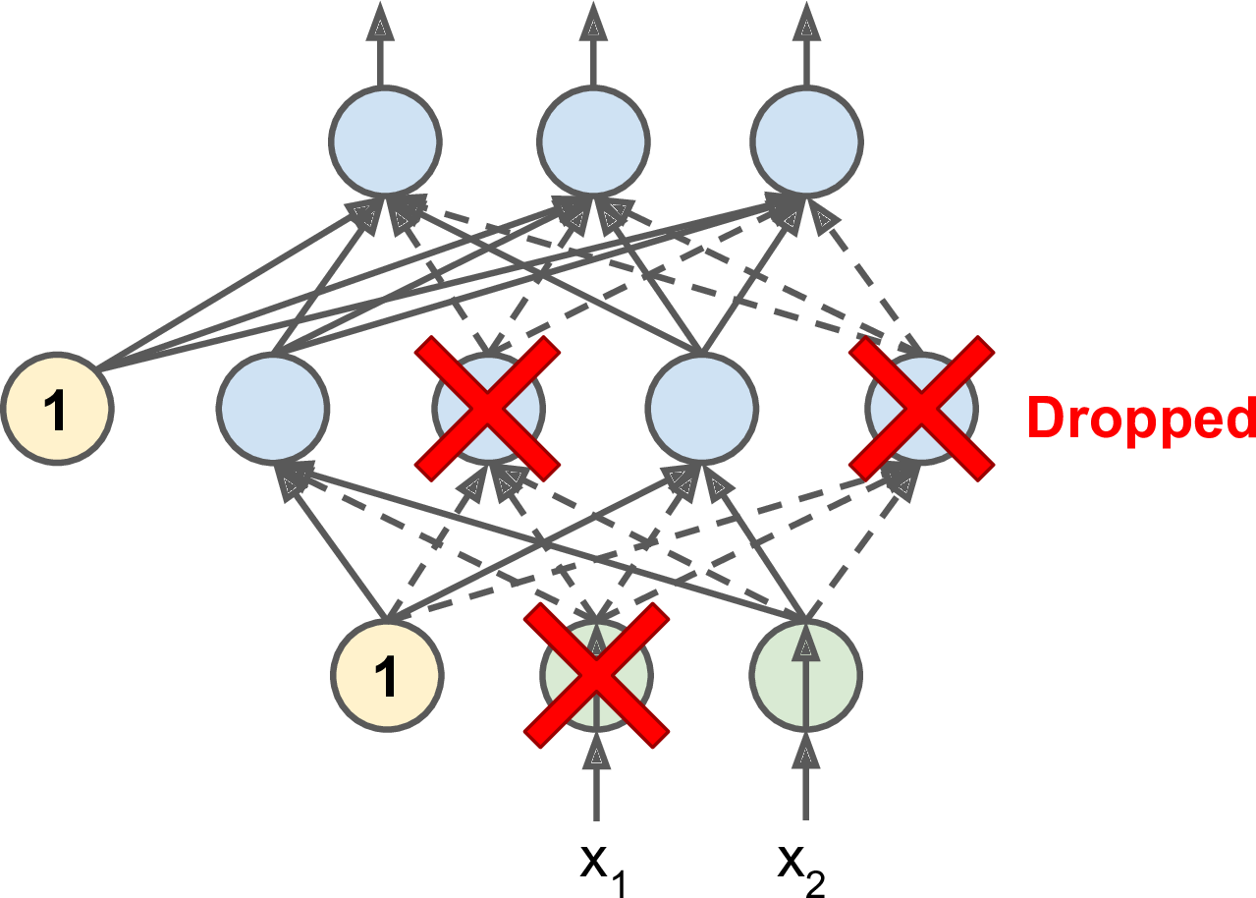
Tools and strategies for training MLPs/DNN
Avoid overfitting through regularization:
Early Stopping
L1 and L2 Regularization
Dropout
Max-norm Regularization
Data Augmentation
Débora/Ayham (UWA)

Slide 47
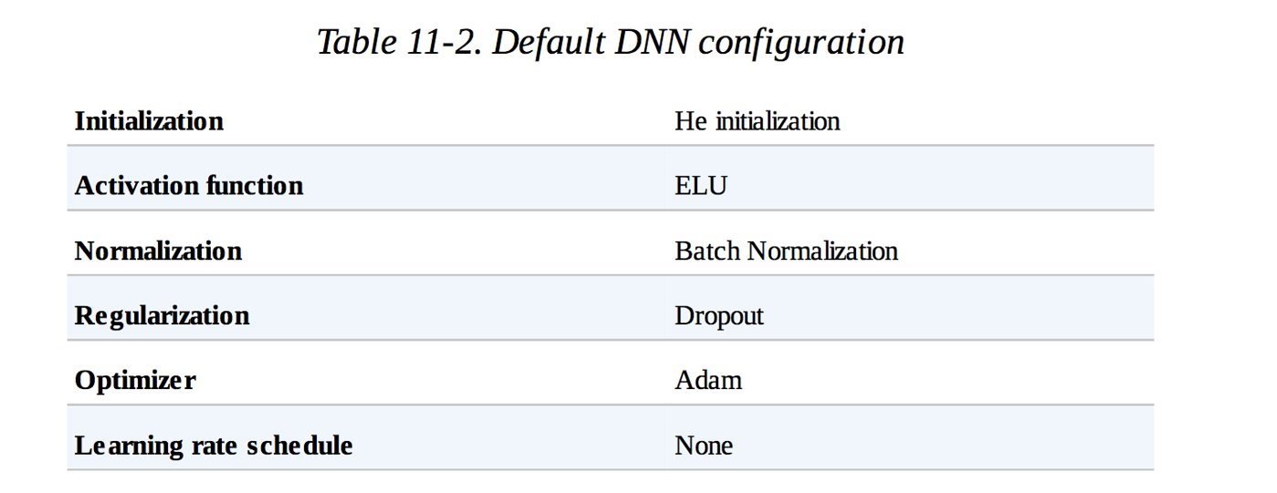
Tools and strategies for training MLPs/DNN
Avoid overfitting through regularization:
Early Stopping
L1 and L2 Regularization
Dropout
Max-norm Regularization
Data Augmentation
Débora/Ayham (UWA)

Slide 48
Day 09 Convolutional Neural Networks (CNNs)

Slide 49
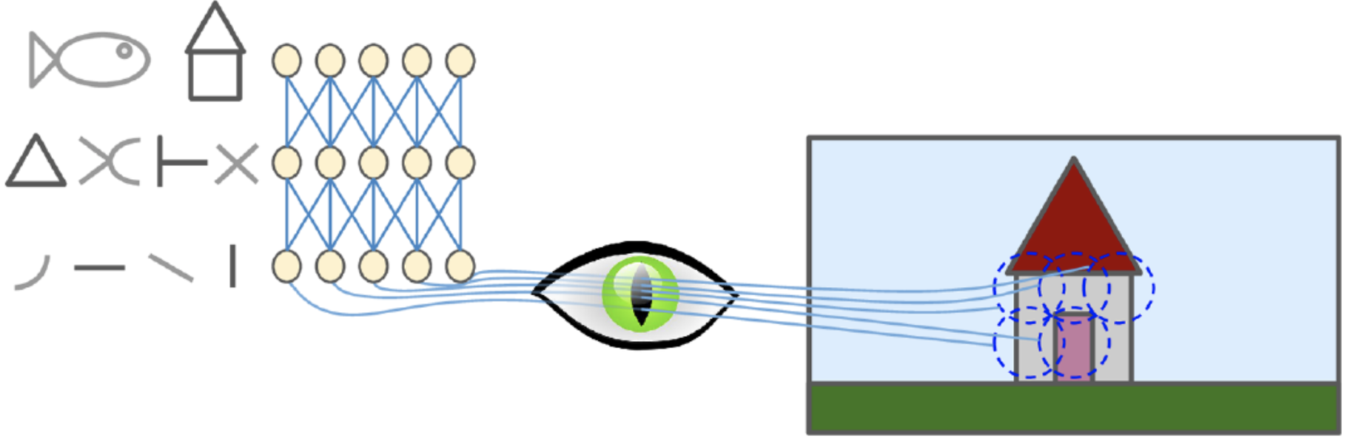
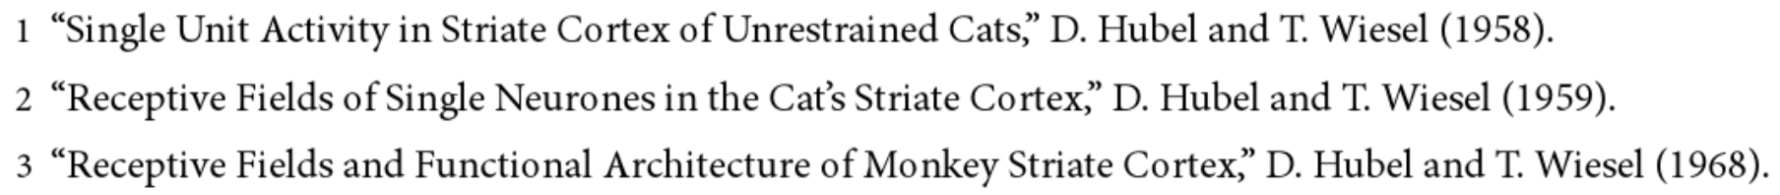
Day 09 CNN Motivation
Insights on the structure of the visual cortex^{1,2,3}
Neurons respond to a small local receptive field: they react to a visual stimuli placed in a small region of the visual field.
Their receptive fields can overlap, and the whole visual field arises from the combination of individual local fields.
Idea that higher-level neurons use the neighboring of lower-level neurons, forming more complex patterns by combining lower-level patterns.
Source: Hands on Machine Learning with Scikit-Learn and TensorFlow, Cap. 13.

Slide 50
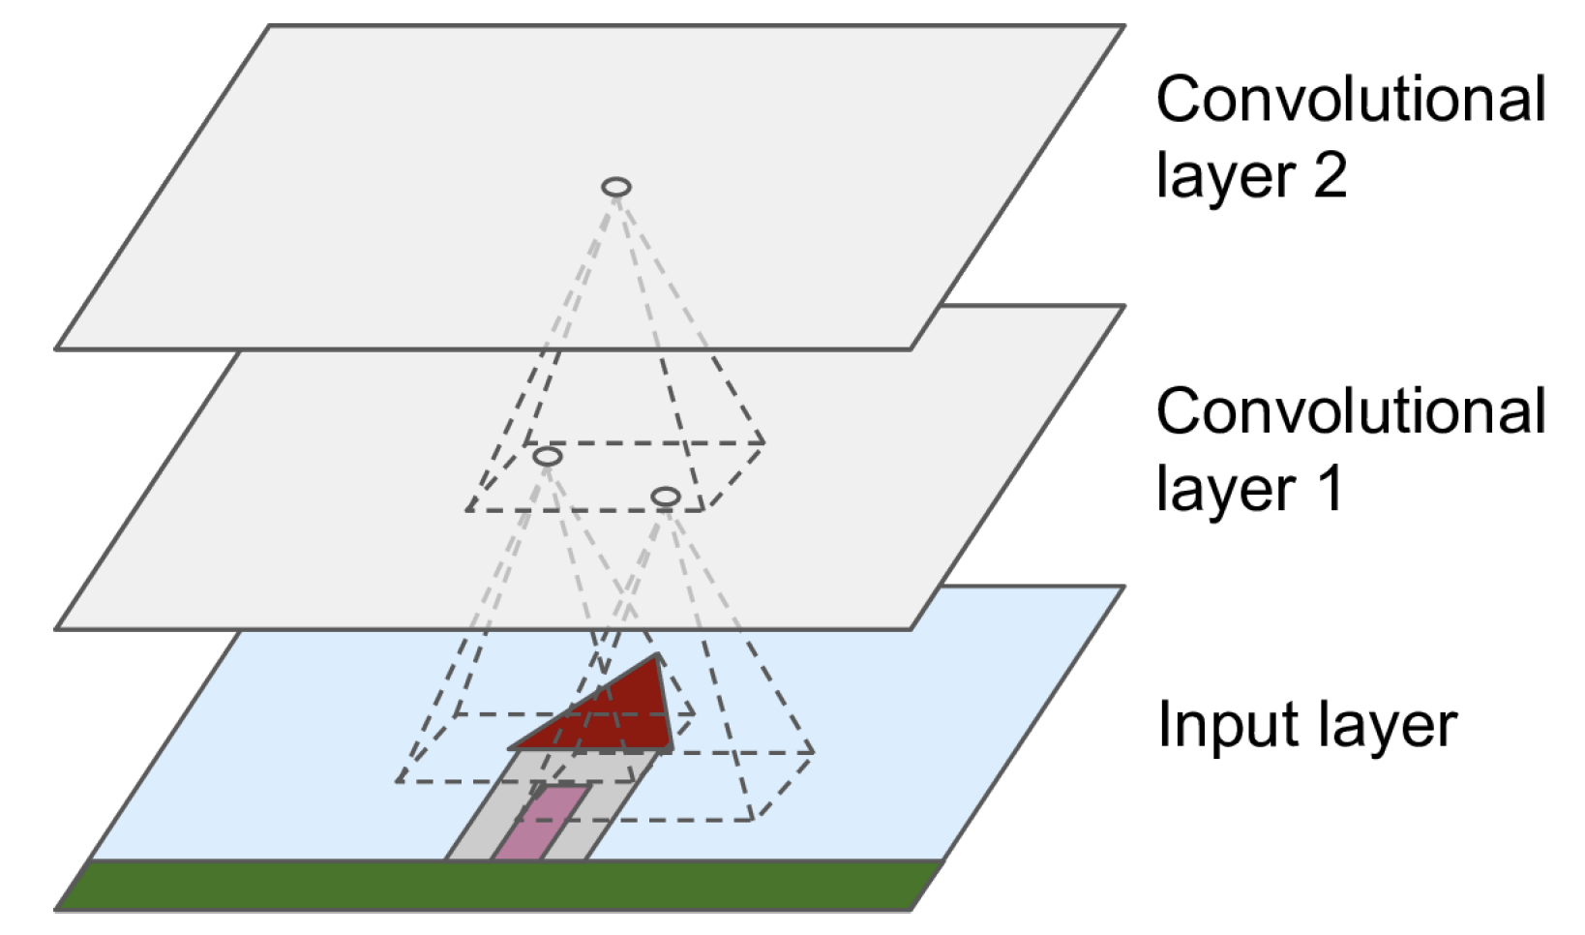

Day 09 Convolutional Layers
Neurons in the first convolutional layer are connected only to a small rectangle of pixels representing their receptive fields.
Each neuron in subsequent layers is connected to neurons located in their receptive field.
Each neuron layer is now 2D
f_{h} and f_{w} define the height and width of the receptive field.
Debora/Ayham (UWA)

Slide 51
Day 09 Convolution
Important operation in image processing.
A (small) kernel matrix is applied to the input image in order to get a transformed image according to a specific task.
Input matrix
Output matrix
95 | 101 | 98 | 102 | 97
96 | 100 | 99 | 101 | 114
99 | 98 | 99 | 99 | 87
94 | 98 | 100 | 102 | 94
89 | 91 | 95 | 98 | 89
100 | 99 | 87 | 89 | 91
104 | 101 | 88 | 93 | 96
Kernel matrix
 | 106
0 | -1 | 0
-1 | 5 | -1
0 | -1 | 0
Multiplication of each element of the kernel with the corresponding element of the image matrix.
(95 * 0) + (101 * -1) + (98 * 0)
+ (96 * -1) + (100 * 5) + (99 * -1)
+ (99 * 0) + (98 * -1) + (99 * 0) = 106

Slide 52




Day 09 Convolution (Cont.)
E.g., edge detection (horizontal, vertical), sharpen, blurring, etc.
0 | 0 | 0
-1 | 2 | -1
0 | 0 | 0
0 | -1 | 0
0 | 2 | 0
0 | -1 | 0
0 | -1 | 0
-1 | 5 | -1
0 | -1 | 0
1 | 2 | 1
0 | 0 | 0
-1 | -2 | -1

Slide 53

Day 09 RGB Images
Source: http://machinelearninguru.com

Slide 54

Day 09 Stacking Multiple Feature Maps
Kernel matrix
0 | -1 | 0
-1 | 5 | -1
0 | -1 | 0
The weights of the kernel and the bias of each feature map are trained with the back-propagation algorithm.
A feature map share the same weights and bias.
An activation function is applied after each convolutional layer.
Source: Hands on Machine Learning with Scikit-Learn and TensorFlow, Cap. 13.

Slide 55

CNN - Intuition
Source: https://devblogs.nvidia.com/deep-learning-nutshell-core-concepts/

Slide 56

Day 09 Pooling layer
Idea: subsample the output of a layers.
Aggregation function, e.g., mean or max.
No weights, but requires the definition of size, stride, padding.
Debora/Ayham (UWA)

Slide 57

Day 09 CNN Architecture
The conventional convolutional neural network is formed by convolutional layers, pooling layers and fully connected layers (with activation functions).
Idea: Generate feature maps that contain relevant (discriminative) and compacted high-level features about the input image.
Final layer outputs the prediction of the class.

Slide 58
CNN vs Deep MLPs
CNNs propose partially connected layers
As all neurons in a feature map share the same weights and bias, CNN models significantly reduces the number of parameters of the model.
E.g., consider 100 x 100 images -> 10,000 pixels. A first MLP layer with 1,000 neurons (quite limited) requires 10 million parameters (just the first layer!).
Location and rotation invariance
CNNs learns a pattern independently of its location and 2D rotation.
Transfer learning.
Debora/Ayham(UWA)

Slide 59

Day 09 Transfer Learning
Time efficient design of accurate deep learning models.
Idea: use of pre-trained models on tasks similar to what you want to solve.
Source: https://towardsdatascience.com/transfer-learning-from-pre-trained-models-f2393f124751
Debora/Ayham (UWA)

Slide 60
Day 09 Powerful architectures
Variants of the fundamental architecture used for transfer learning.
InceptionV4
https://arxiv.org/pdf/1602.07261.pdf
VGG
http://www.robots.ox.ac.uk/~vgg/practicals/cnn/index.html
GoogLeNet
https://ai.google/research/pubs/pub43022
ResNet
https://www.cv-foundation.org/openaccess/content_cvpr_2016/html/He_Deep_Residual_Learning_CVPR_2016_paper.html

Slide 61
Day 9 Recurrent Neural Networks (RNNs)

Slide 62

Sequence models
When to use sequence models?
Temporal dynamics connecting data samples are important.
Context is important: past samples or decisions influence current predictions.
Share features across different positions of the data is important.
1 - ChandolaV, Banerjee A, Kumar V. Anomaly detection: A survey. ACM computing surveys (CSUR). 2009 Jul 1;41(3):15.
2 - MirikitaniDT, NikolaevN. Recursive bayesianrecurrent neural networks for time-series modeling. IEEE Transactions on Neural Networks. 2010 Feb;21(2):262-74.
3 - https://cs.gmu.edu/~xwang24/Projects/RPM.html
4 - Zak, G, et al. Application of ARMA modelling and alpha-stable distribution for local damage detection in bearings, Diagnostyka,2014.
Débora/Ayham (UWA)

Slide 63

The Recurrent Neural Network Model
Similar to their feedforward counterpart, but including loop connections, allowing information to persist.
Débora/Ayham (UWA)
Source: Hands on Machine Learning with Scikit-Learn and TensorFlow,Cap. 14.

Slide 64



The RNN computations
Débora/Ayham (UWA)
Source: Hands on Machine Learning with Scikit-Learn and TensorFlow,Cap. 14.

Slide 65

The RNN computations
Débora/Ayham (UWA)
Source: Hands on Machine Learning with Scikit-Learn and TensorFlow,Cap. 14.

Slide 66
Backpropagation through time
Forward pass: Training instances are fed to the network and output are computed.
Backward pass: Measures the error gradients (in all time steps) with respect to all parameters in the network by (back)propagating the error gradient.
Débora/Ayham (UWA)
Source: P. J. Werbos, 1990. Backpropagation through time: what it does and how to do it

Slide 67

Vanishing Gradients
A basic RNN algorithm very often runs into vanishing gradient problems.
To train it on long sequences, many time steps make the unrolled RNN similar to a very deep network.
The gradients get smaller and smaller as GD goes down to the lower layers - for which connection weights remain practically unchanged.
Pascanuet al., 2013. On the difficulty of training recurrent neural networks.
Sentence examples from https://cs224d.stanford.edu/lecture_notes/LectureNotes4.pdf.
Débora/Ayham (UWA)

Slide 68

Advanced RNNs
Débora/Ayham (UWA)

Slide 69

Advanced RNNs – Long Short-term Memory (LSTM)
The LSTM cell learns long-term dependencies in the data, and training usually converge faster than with the basic RNNs.
S. Hochreiterand J. Schmidhuber, 1997. Long Short-term Memory.
Gers et al., 1999. Learning to forget: continual prediction with LSTM.
http://colah.github.io/posts/2015-08-Understanding-LSTMs
Débora/Ayham (UWA)

Slide 70

Advanced RNNs – LSTM forward pass
The cell state c^{t} is the important aspect of the LSTM: it flows the information related to long-term memories.
The short-term state h^{t} works similar as the basic RNN cell, and its output goes directly to y^{t}.
Variants and improvements:
F.A. Gers and J. Schmidhuber, 2000. Recurrentnets that time and count.
Gers et al., 2002, Learning Precise Timing with LSTM Recurrent Networks.
Zarembaet al., 2015, Recurrent Neural Network Regularization.
Débora/Ayham (UWA)

Slide 71


Advanced RNNs – Gated Recurrent Unit (GRU) cell
The GRU cell is a simpler (but effective) variant of the LSTM cell.
GRU and LSTM cells have showed similar results for many tasks.
Cho et al., 2014. Learning Phrase Representations using RNN Encoder–Decoder for Statistical Machine Translation.
Cho et al., 2014. On the Properties of Neural Machine Translation: Encoder - Decoder Approaches.
Chung et al., 2014. Empirical evaluation of gated recurrent neural networks on sequence modeling.
Greffet al., 2015. LSTM: A Search Space Odyssey.
Jozefowiczet al., 2015. An Empirical Exploration of Recurrent Network Architectures.
Débora/Ayham (UWA)

Slide 72

Types of RNN
Débora/Ayham (UWA)

Slide 73
Discussion
What are ANNs possible applications in industry?
Débora/Ayham (UWA)

Slide 74
Discussion
What are ANNs possible applications in industry?
Use of satellite images (remote sensing) to map the impacts to the environments of mining actives. Aim: identify locations which require attention in order to prevent extreme impact and fine from the government.
Real-time analysis of components in a haul truck for predictive analysis, for instance, to identify whether this component is getting extreme heating when in operation.
Given images from minerals, identify the quality of such materials.
Identification of high risk areas for slips, trips and falls in order to assist with workers' security.
Preventive analysis of fires in underground mines.
Prediction of sky clearness and solar radiations for solar energy applications.
Forecast of electrical energy consumption.
Débora/Ayham (UWA)

